Slide 1
Starting An Online Business
Prepared by SHEN HO

Slide 2
Ask yourself these questions:
1. WHAT DO PEOPLE NEED?
You identify something people need and are willing to pay for, and you provide it at a reasonable price.
Question: how you going to identify it?

Slide 3
Ask yourself these questions:
2. WHAT DO YOU HAVE TO OFFER?
Self-assessment and advance planning play a role here. Make a list of what you can do, and what you know about, including:

Slide 4
Ask yourself these questions:
  Something that gives you energy rather than drains you
  Your hobbies
  Your work experience
  Your computer experience
  Any programming expertise you might have
  Any source of wholesale merchandise you already have

Slide 5
Ask yourself these questions:
  ACTIVITY: MAKE A LIST OF ABOVE MENTIONED ITEMS

Slide 6
Ask yourself these questions:
3. DO YOU HAVE SPECIALIZED KNOWLEDGE OR EXPERIENCE?
Finding customers isn’t just a matter of matching what they want to what you have. That’s important, to be sure, but you also need to build trust. Your customers will never meet you in person. They will always feel some uncertainty after they pay you online, hoping you’ll actually deliver what you say you will.

Slide 7
Ask yourself these questions:
How to build trust?
One of the best ways to build trust is to tell visitors why you are qualified to sell what you’re selling, or to discuss what you are talking about. You might say something like this:

Slide 8
Ask yourself these questions:
I’ve been selling stamps online and at stamp shows for many years. I started selling while I had a coin and hobby shop in suburban Chicago. I am a member of the National Stamp Sellers of America, and I regularly answer questions about stamps on a variety of newsgroups. I have a feedback rating of 1,215 on eBay and am a Top-Rated Seller. I offer a seven-day return policy.

Slide 9
Ask yourself these questions:
Activity 1: Think of something that you interested to sell to consumers.
Activity 2: Tell the consumers why you are qualified to sell it?

Slide 10
Ask yourself these questions:
4. DO YOU HAVE CONNECTIONS TO SUPPLIERS?
You should find a supplier with the following in mind:
  You should be continually trying to improve both the quality and quantity of your inventory.
  You need to think big: boost the number of items you already purchase so you can sell more.
  Expand your sales options and your price range.

Slide 11
Ask yourself these questions:
No matter where you are located or where you sell, obtaining a legal document that identifies you as a certified reseller is a good idea. That way wholesalers will trust you. Some states call such a document a resale certificate; in other states, it’s called a certificate of resale, or something similar.

Slide 12
Ask yourself these questions:
5. WHAT DO YOU LOVE?
The thing you need to sell, or write about on your blog, or remote on an informational website, is
  Something that gives you energy rather than drains you of it.
  Something you won’t get tired of working with several hours each day.
  Something that (if it’s a product) is relatively easy to pack and ship.

Slide 13
Ask yourself these questions:
Take advantage of any expertise and experience you have in your chosen area of interest. If you have certifications, list them.
Your authority builds trust and makes visitors feel good about asking you questions or making purchases from you.

Slide 14
Ask yourself these questions:
6. What do you have on hand?
Take photos and write descriptions and put your merchandise up for sale on venues such as:
  eBay - eBay is still a great place to get a new business off the ground and get experience.

Slide 15
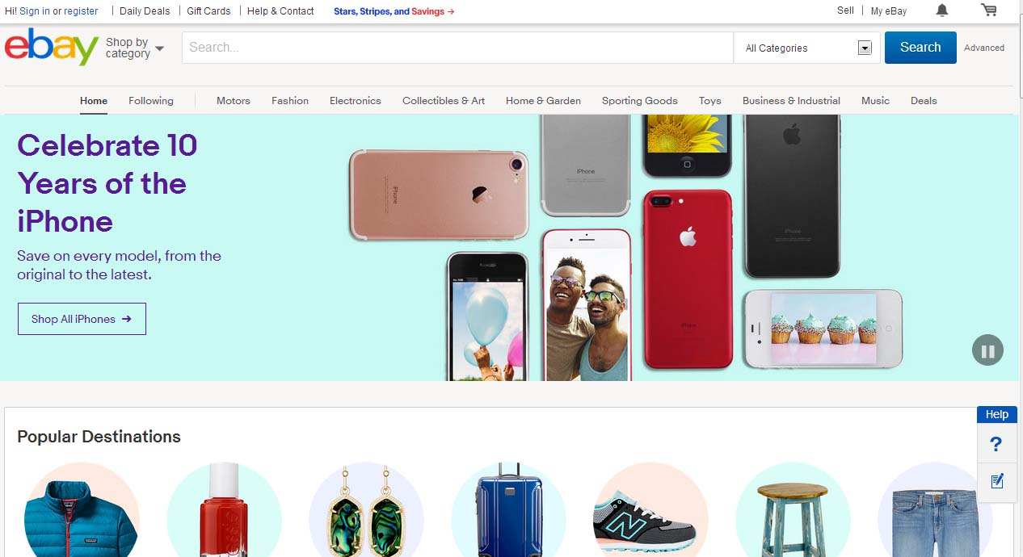
Ask yourself these questions:

Slide 16
Ask yourself these questions:
7. What do your friends and family have?
Selling things for other people is a great way to get a lot of merchandise online quickly.
Being a consignment seller will build up your positive feedback as well. That way, when you start selling a more steady supply online, you’ll already have a track record and people will trust you.

Slide 17
Ask yourself these questions:
8. Does someone already do what you want to do?
Very few online businesses are totally original. Most everyone begins by imitating what someone else has done before.
Just consider one of the biggest businesses of recent years, Microsoft, which has often reworked software originally created by Apple and other developers.

Slide 18
Ask yourself these questions:
The key is not to simply copy what others have done but to personalize it, do it better, and make your business uniquely yours. Scan the web for sites that sell what you want to do, or look up blogs that cover material similar to what you want to talk about.

Slide 19
Ask yourself these questions:
Activity: How to undercut competition? Think of it and list down few strategies.
What kinds of promotions, contests, quizzes, or sales discounts can you offer to undercut the competition?

